Slide 1

Challenging HOG's Pedestrian Detection Accuracy
Sherdan Caruana
Institute of Information & Communication Technology
MCAST, Paola, Malta

Slide 2
Problem Definition
Pedestrian detection systems can be used to monitor the upcoming road and alert the driver to avoid accidents of any pedestrians that are crossing.
Pedestrians crossing the street and drivers not being alert can lead to accidents.
In complicated urban scenarios, pedestrians can be hard to see, especially around sharp corners, which can cause accidents.

Slide 3
Literature
Topic Pedestrian detection with the HOG algorithm
Domain Human Detection, Urbain Safety
Computer vision with HOG algorithm + SVM
Euro city, Cityscapes Datasets

Slide 4
Literature
Y. Pang, Y. Yuan, X. Li, and J. Pan, “Efficient hog human detection,”
S. Zhang, R. Benenson, and B. Schiele, “Citypersons: A diverse dataset for pedestrian detection,” in Proceedings of the IEEE Conference on Computer Vision and Pattern Recognition (CVPR). IEEE, 2017, pp. 3213–3221.
W. R. W. H. Y. Y. Wei Liu, Shengcai Liao, “High-level semantic feature detection: Anewperspective for pedestrian detection,” Proceedings of the IEEE/CVF Conference on Computer Vision and Pattern Recognition (CVPR), pp. 5187–5196, 2019.

Slide 5
Methodology – Aim, Hypothesis, Questions
The research challenges an implemented HOG based algorithm with multiple varying challenges to try and replicate a real-life scenarios

Slide 6
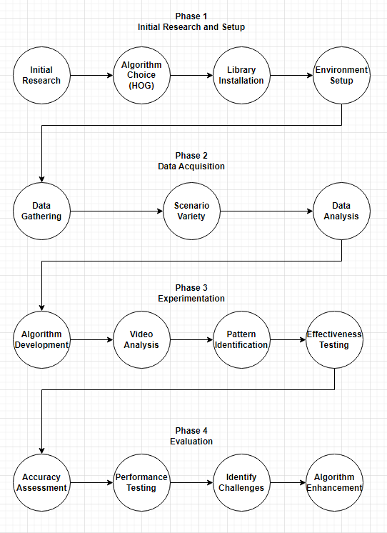
Methodology – Pipeline
The algorithm provided by Navneet Dalal and Bill Triggs can be downloaded and experimented on from geeksforgeeks
https://www.geeksforgeeks.org/pedestrian-detection-using-opencv-python/

Slide 7
Prototype
Video Link: https://youtu.be/o2IoZfYUITI

Slide 8
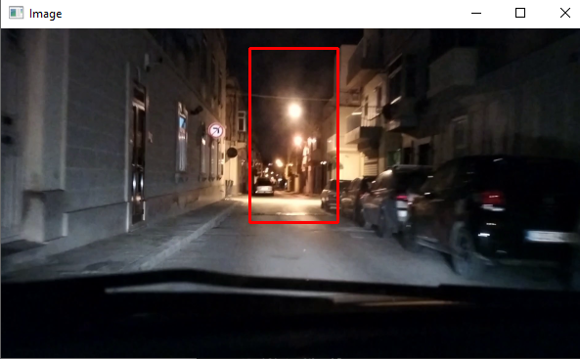
Experiments
Experiment 1: Impact of Lighting on Detection Process
During the day, the algorithm demonstrated good performance in detecting pedestrians
However, at night the program showed an increase in false positives towards bright lights

Slide 9
Experiments
Experiment 2: Effect of Compression and Resolution on Detection Quality
Tests conducted with videos at various resolutions
400 pixels (standard) balances detection performance and false positives.
700 pixels (higher resolution) improves detection but increases false positives.
200 pixels (lower resolutions) reduces false positives but struggles with distant pedestrian detection.

Slide 10
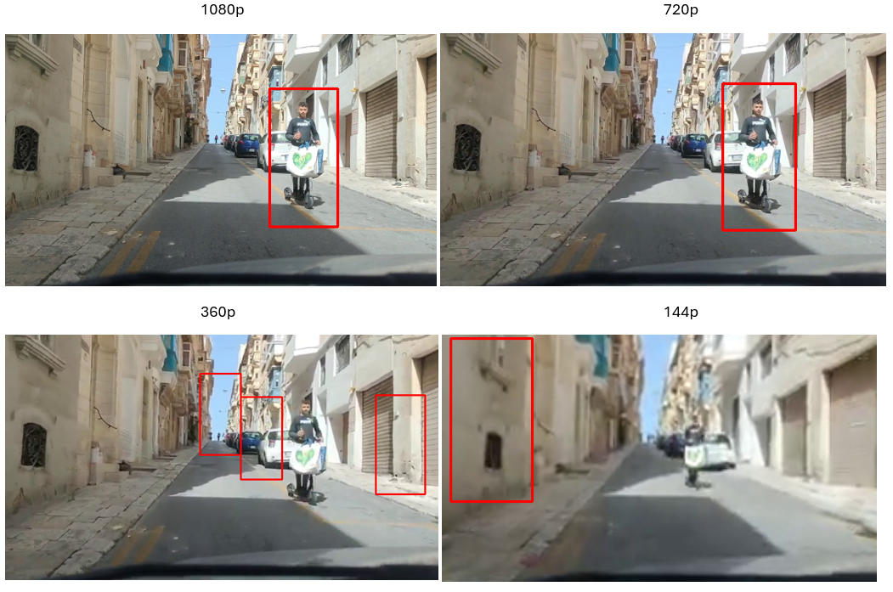
Experiments
Experiment 3: Influence of Video Quality on Detection Process
1080p Good detection with low false positives
720p Good detection with low false positives
360p Poor detection with hight false positives
144p Poor detection wight high false positives and high false negatives

Slide 11
3rd party comparison
The research more focuses on the different environments such as lighting, video quality and resolution.
Indications of the HOG algorithm struggling with false positives.
The impact that these types of environments and video quality causes on such a detection process

Slide 12
Research Question evaluation
How does lighting conditions, impact the pedestrian detection?
How did video resolution influence the effectiveness of the detection system?
How does the video quality, particularly lower quality versus higher quality, affect the accuracy of the detection?

Slide 13
Conclusions - Achievements
Developed a pedestrian detection program using Python, OpenCV, and the Histogram of Oriented Gradients (HOG) algorithm.
Lighting Conditions: algorithm performs well in optimal lighting but faces challenges in low-light conditions
Resolution : higher resolution improves detection accuracy but may increase false positives, lower resolution reduces false positives but can miss distant pedestrians
Quality Variations: algorithm is sensitive to video quality, lower quality videos resulting in decreased detection and increased false positives

Slide 14
Conclusions - Limitations
False Positives: Occurrence of multiple false positives plagued the results, particularly in low-light conditions and cluttered environments.
False Negatives: Occasionally it missed detecting pedestrians, especially those at the edge of the video or at long distance

Slide 15
Conclusions - Recommendations
Explore advanced feature extraction techniques such as Convolutional Neural Networks (CNNs) and YOLO algorithms for better improvement
Utilization of the GPU acceleration to enhance the speed and efficiency of the detection system.

Slide 16
References
Y. Pang, Y. Yuan, X. Li, and J. Pan, “Efficient hog human detection,”
S. Zhang, R. Benenson, and B. Schiele, “Citypersons: A diverse dataset for pedestrian detection,” in Proceedings of the IEEE Conference on Computer Vision and Pattern Recognition (CVPR). IEEE, 2017, pp. 3213–3221.
W. R. W. H. Y. Y. Wei Liu, Shengcai Liao, “High-level semantic feature detection: Anewperspective for pedestrian detection,” Proceedings of the IEEE/CVF Conference on Computer Vision and Pattern Recognition (CVPR), pp. 5187–5196, 2019.
Tian, D., Han, Y., Wang, B., Guan, T., & Wei, W. (2021). [Retracted] A Review of Intelligent Driving Pedestrian Detection Based on Deep Learning. Volume 2021

Slide 17
Thank you Sherdan Caruana sherdan.caruana.d57125@mcast.edu.mt

